Slide 1

Student Presentation Guidelines
Sung-Eui Yoon
(윤성의)
Notes:
1

Slide 2
Expectations
Good summary, not full detail, of the paper
Talk about motivations of the work
Give a broad background on the related work
Explain main idea and results of the paper
Discuss strengths and weaknesses of the method

Slide 3
High-Level Ideas
Deliver most important ideas and results
Do not talk about minor details
Give enough background instead
Deeper understanding on a paper is required
Go over at least two related papers and explain them in a few slides
Spend most time to figure out the most important things and prepare good slides for them
If possible, re-use existing slides/videos (with ack.)

Slide 4
Overall Structure
Prepare an overview slide
Talk about most important things and connect them well

Slide 5
Be Honest
Do not skip important ideas that you don’t know
Explain as much as you know and mention that you don’t understand some parts
If you get questions you don’t know good answers, just say it
In the end, you need to explain them before the semester ends

Slide 6
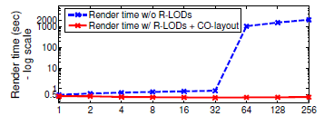
Result Presentation
Give full experiment settings and present data with the related information
What does the x-axis mean in the below image?
After showing the data, give a message that we can pull of the data
Show images/videos, if there are

