Slide 1

Differentiable Rendering: two techniques
CS580 Computer Graphics
20184364 Hangyeol Yu

Slide 2
Review
from Nick's slide

Slide 3
Denoising Monte Carlo Sequences
Interactive Reconstruction of Monte Carlo Image Sequences using a Recurrent Denoising Autoencoder
Gradient Estimation for Real-Time Adaptive Temporal Filtering
Review

Slide 4
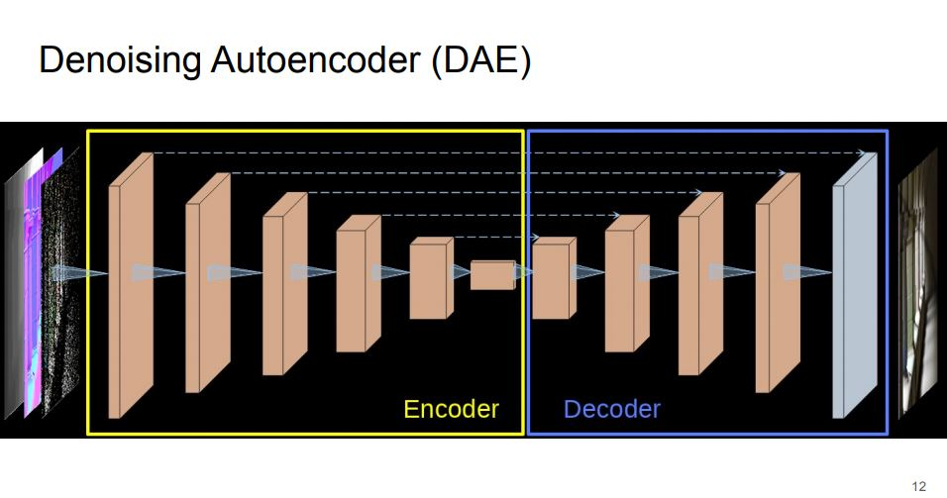
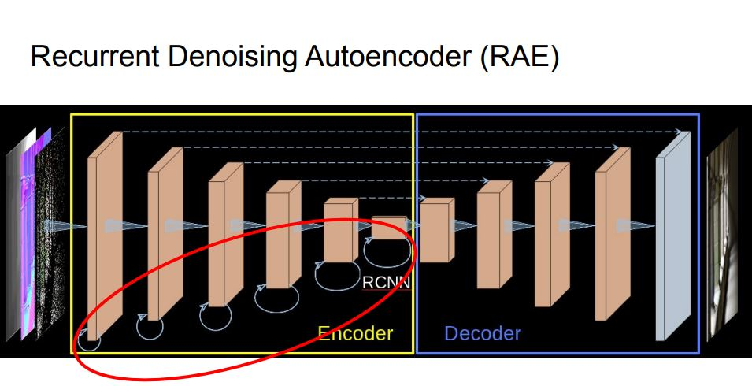
Recurrent Denoising Autoencoder
Review

Slide 5
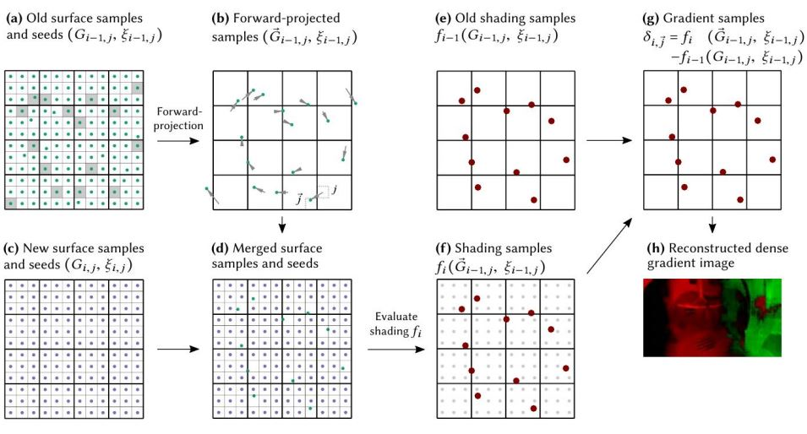
Gradient Estimation for Real-Time Adaptive Temporal Filtering
Review

Slide 6
Introduction

Slide 7

Rendering as a function
3D mesh (vertices and surfaces)
camera position
camera angle
light position
texture
….
Pixel Color
Scene
Rendering
$$F :Φ↦I$$
Introduction

Slide 8
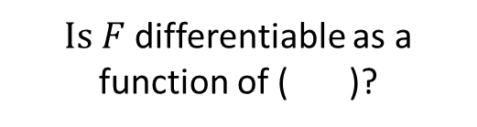
Differentiable rendering?
3D mesh (vertices and surfaces)
camera position
camera angle
light position
texture
….
Pixel Color
Scene
Rendering
$$F :Φ↦I$$
$Is F$differentiable as a function of ( )?
Introduction

Slide 9
Differentiable rendering?
3D mesh (vertices and surfaces)
camera position
camera angle
light position
texture
….
Pixel Color
Scene
Rendering
$$F :Φ↦I$$
$Is F$differentiable as a function of ( )?
Introduction

Slide 10
Differentiable rendering?
3D mesh (vertices and surfaces)
camera position
camera angle
light position
texture
….
Pixel Color
Scene
Rendering
$$F :Φ↦I$$
$Is F$differentiable as a function of ( )?
Introduction

Slide 11
Differentiable rendering?
3D mesh (vertices and surfaces)
camera position
camera angle
light position
texture
….
Pixel Color
Scene
Rendering
$$F :Φ↦I$$
$Is F$differentiable as a function of ( )?
Introduction

Slide 12
Why differentiable rendering?
Most of machine learning techniques are based on differentiable networks and back propagation.
We can put the renderer between neural nets and run powerful machine learning engine.
Applications: inverse graphics, 3D Deep Dream, style-transfer …
Introduction

Slide 13
Background

Slide 14
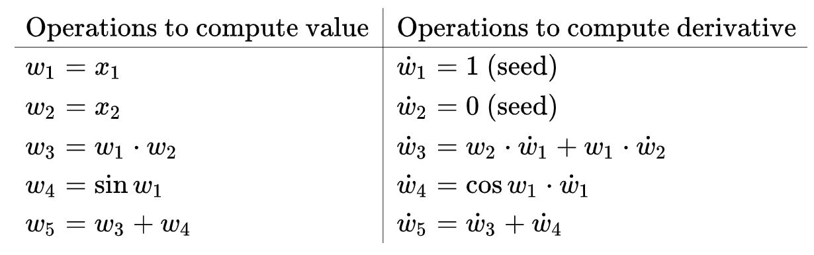
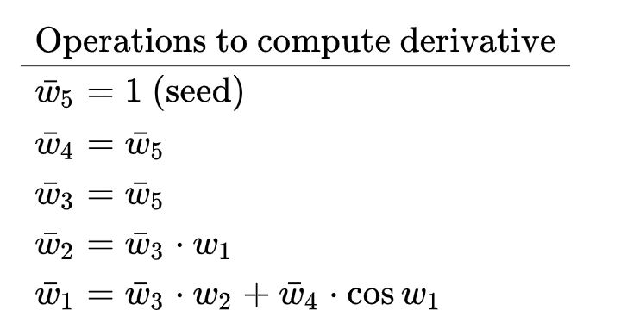
Automatic Differentiation(AD)
Forward mode AD
Reverse mode AD
w1
w4
x1
w5
w2
w3
x2
Background
https://en.wikipedia.org/wiki/Automatic_differentiation

Slide 15
Automatic Differentiation(AD)
Forward mode AD
Reverse mode AD
w1
w4
x1
w5
w2
w3
x2
Background
https://en.wikipedia.org/wiki/Automatic_differentiation

Slide 16
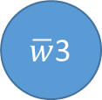




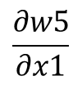

Automatic Differentiation(AD)
Forward mode AD
Reverse mode AD
$$\frac{∂w5}{∂x1}$$
$\overline{w}$1
$\overline{w}$4
Back propagation = reverse mode AD !
$\overline{w}$5
$$\frac{∂w5}{∂x2}$$
$\overline{w}$2
$\overline{w}$3
Background
https://en.wikipedia.org/wiki/Automatic_differentiation

Slide 17
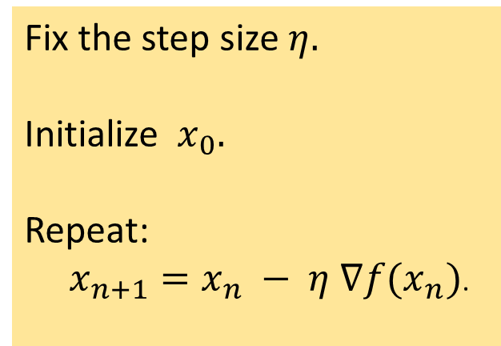
Gradient Descent
F(x)
Fix the step size $η.$
Initialize ${ x}_{0}.$
Repeat:
$x_{n+1}=x_{n} − η ∇f(x_{n})$.
x

Slide 18
Neural 3D Mesh Renderer

Slide 19
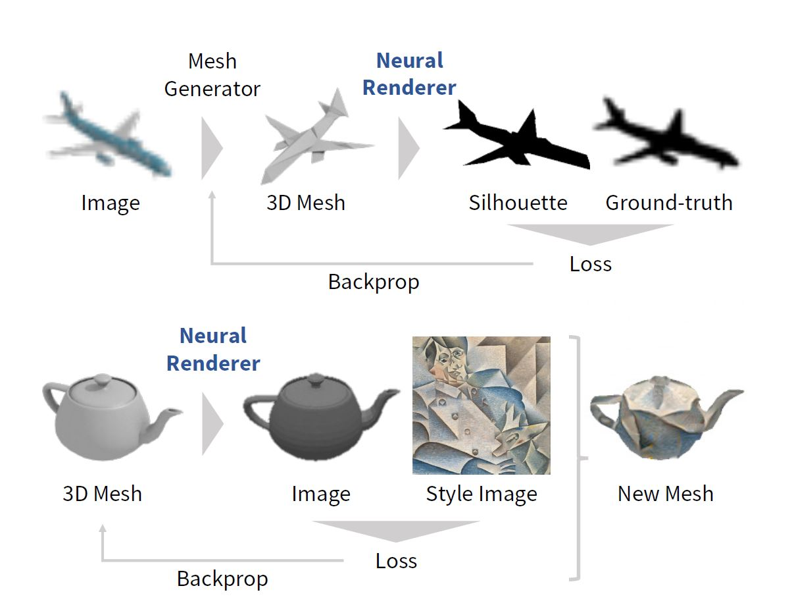
Overview
This paper proposed an approximate gradient for rasterization of a mesh.
Regarded the renderer as a function of 3D mesh to 2D image.
3D meshes are reconstructed from single images without 3D supervision and
They performed gradient-based 3D mesh editing operations such as 2D-to-3D style transfer.
w1
x1
Neural Renderer
w5
w2
w3
x2
Neural 3D Mesh Renderer

Slide 20
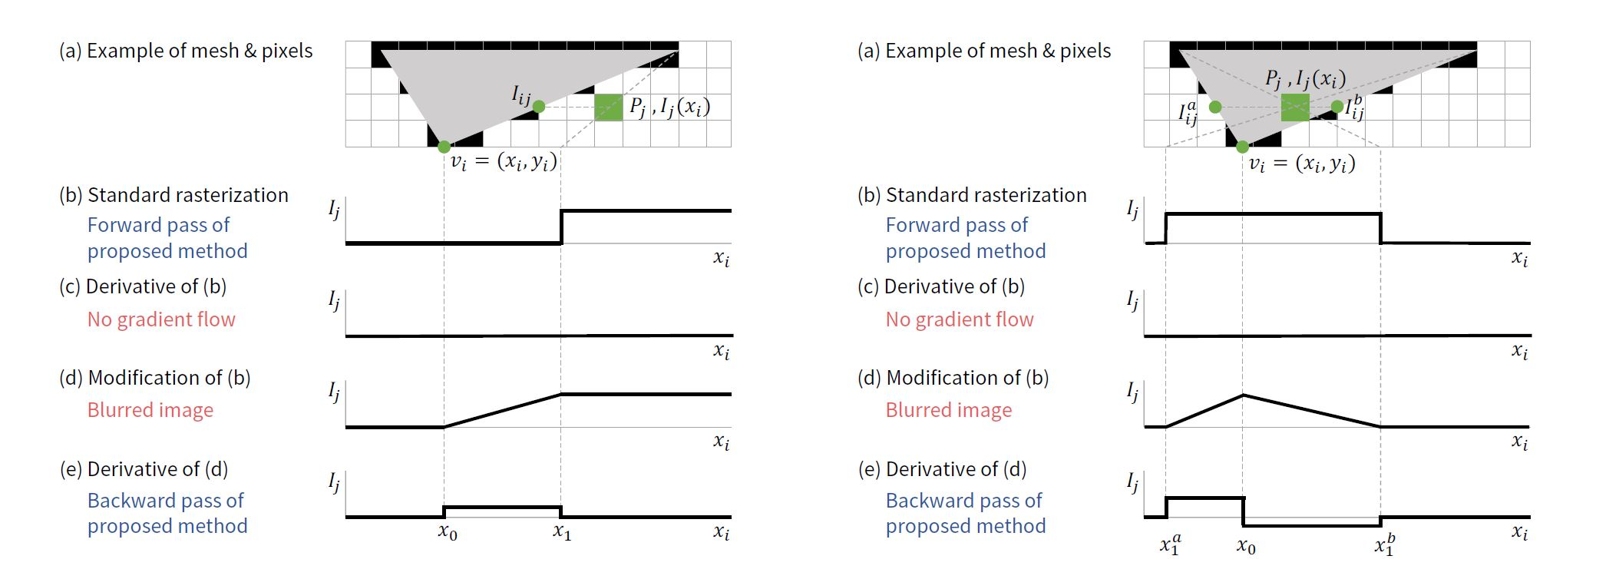
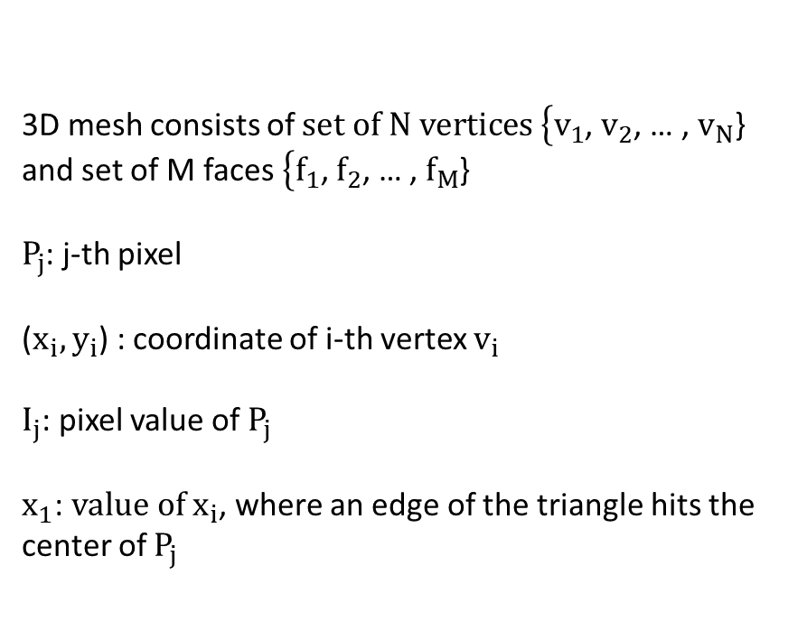
Observation
3D mesh consists of $set of N vertices \left\{v_{1}\right.$, $v_{2}$, … , $v_{N}$} and set of M faces$\left\{f_{1}\right.$, $f_{2}$, … , $f_{M}$}
$P_{j}$: j-th pixel
($x_{i}, y_{i}$) : coordinate of i-th vertex $v_{i}$
$I_{j}$: pixel value of $P_{j}$
$x_{1}$: $value of x_{i}$, where an edge of the triangle hits the center of $P_{j}$
Neural 3D Mesh Renderer

Slide 21
Observation
3D mesh consists of $set of N vertices \left\{v_{1}\right.$, $v_{2}$, … , $v_{N}$} and set of M faces$\left\{f_{1}\right.$, $f_{2}$, … , $f_{M}$}
$P_{j}$: j-th pixel
($x_{i}, y_{i}$) : coordinate of i-th vertex $v_{i}$
$I_{j}$: pixel value of $P_{j}$
$x_{1}$: $value of x_{i}$, where an edge of the triangle hits the center of $P_{j}$
Neural 3D Mesh Renderer

Slide 22
Observation
3D mesh consists of $set of N vertices \left\{v_{1}\right.$, $v_{2}$, … , $v_{N}$} and set of M faces$\left\{f_{1}\right.$, $f_{2}$, … , $f_{M}$}
$P_{j}$: j-th pixel
($x_{i}, y_{i}$) : coordinate of i-th vertex $v_{i}$
$I_{j}$: pixel value of $P_{j}$
$x_{1}$: $value of x_{i}$, where an edge of the triangle hits the center of $P_{j}$
Neural 3D Mesh Renderer

Slide 23
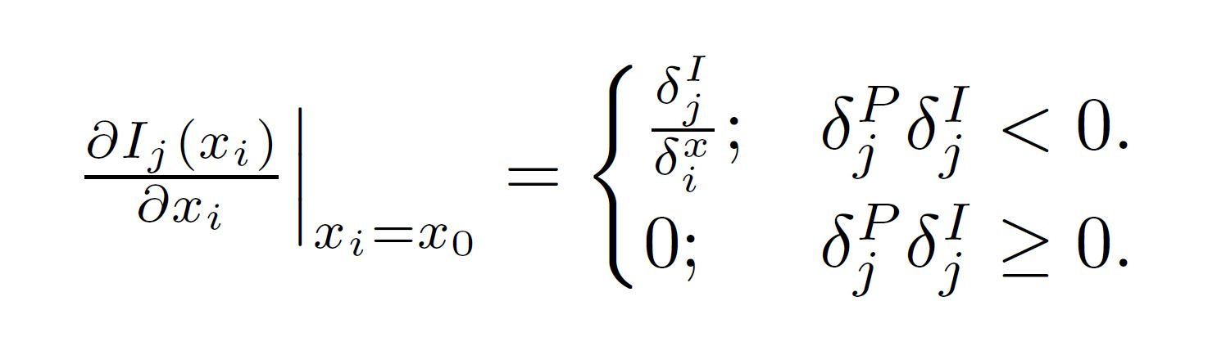



Rasterization of a single face
$δ_{i}^{x}$ = $x_{1}$- $x_{0}$
$δ_{i}^{I}$ = $I_{j}(x_{1}$) -${ I}_{j}(x_{0}$)
$δ_{i}^{P}$ = signal back propagated to $P_{j}$
Neural 3D Mesh Renderer

Slide 24
Rasterization of a single face
Neural 3D Mesh Renderer

Slide 25
Rasterization of multiple faces
The renderer draws only the front-most face at each pixel.
Do not flow gradients if they are occluded by surfaces not including vi.
Neural 3D Mesh Renderer

Slide 26
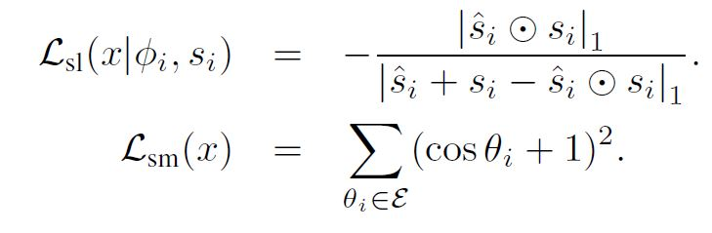
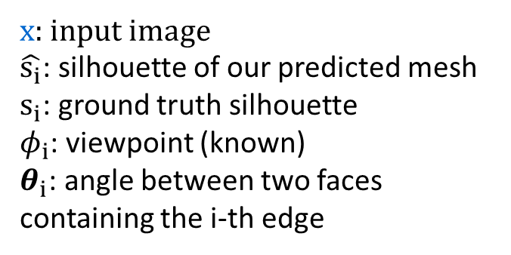
Experiment:
Single image 3D reconstruction
x: input image
$\hat{s_{i}}$: silhouette of our predicted mesh
$s_{i}$: ground truth silhouette
$φ_{i}$: viewpoint (known)
$θ_{i}$: angle between two faces containing the i-th edge
Silhouette Loss
Smootheness Loss
Neural 3D Mesh Renderer

Slide 27
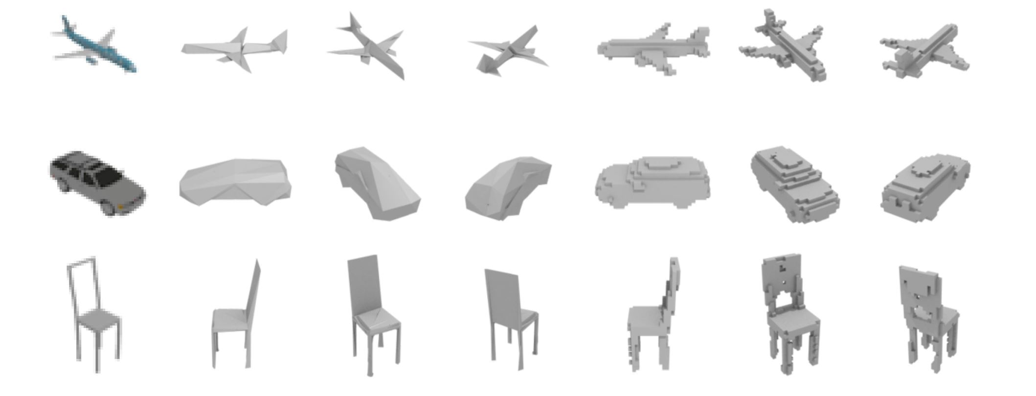
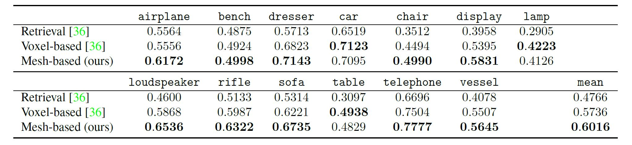
Result
Result
Reconstruction Accuracy (Boxel IoU)
Neural 3D Mesh Renderer

Slide 28
Experiment 2:
2D-3D style transfer
Neural 3D Mesh Renderer

Slide 29
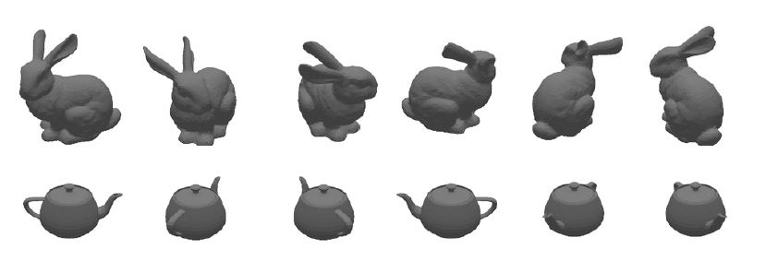
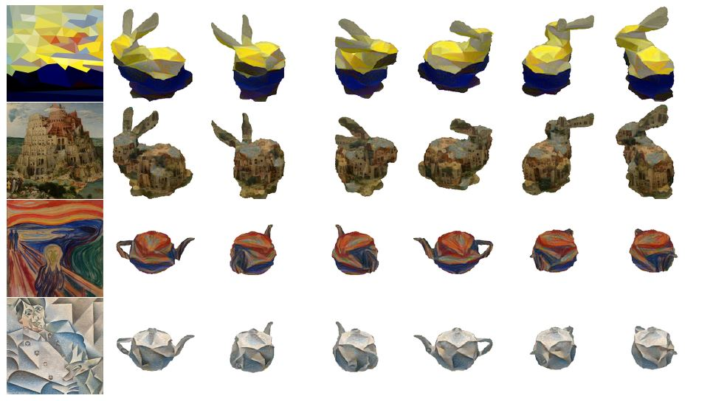
Result 2
Neural 3D Mesh Renderer

Slide 30
Summary
Differentiation with respect to 3D mesh (position of vertices).
Approximate gradient (biased) by linear interpolation.
For rasterization only.
It does not support shading effects.
Neural 3D Mesh Renderer

Slide 31
Differentiable Monte Carlo Ray Tracing through Edge Sampling

Slide 32
Overview
General-purpose differentiable Monte Carlo ray tracer
We can compute derivatives of scalar functions over a rendered image with respect to arbitrary scene parameters such as camera pose, scene geometry (3D mesh), materials, and lighting parameters.
Differentiable MC Ray Tracing

Slide 33
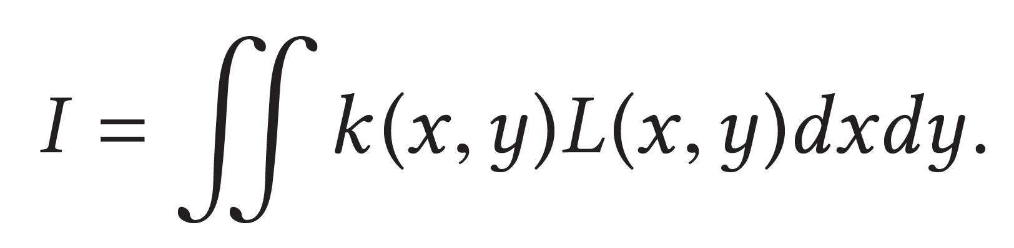
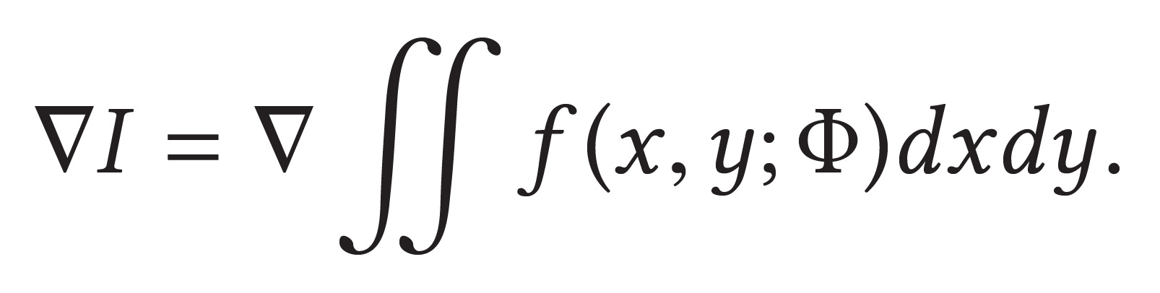
Primary visibility
I : value of certain pixel
(x, y) : a point on the image plane
k : filter
L : radiance
Φ : scene parameter
f : scene function
Differentiable MC Ray Tracing

Slide 34


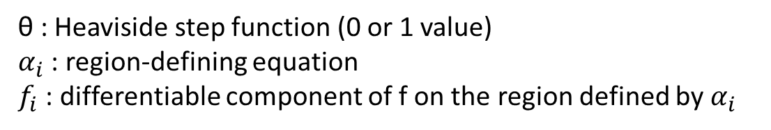


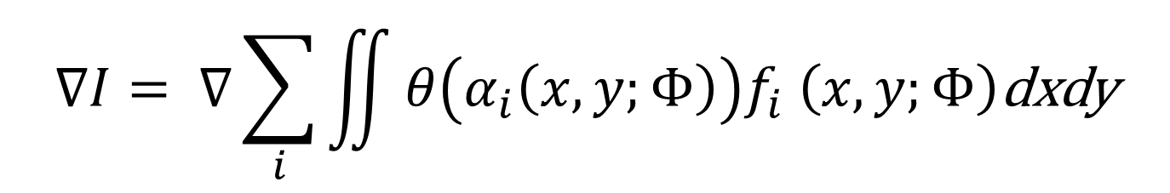

Primary visibility
θ : Heaviside step function (0 or 1 value)
$α_{i}$ : region-defining equation
$f_{i}$ : differentiable component of f on the region defined by $α_{i}$
$$(x,y)$$
$$f_{1}$$
$$f_{3}$$
$$f_{2}$$
$$∇I= ∇\sum_{i}{\iint{θ\left(α_{i}\left(x, y;Φ\right)\right)f_{i} \left(x, y;Φ\right)\text{dxdy}}}$$
Differentiable MC Ray Tracing

Slide 35



Primary visibility (Leibniz’s rule)
$$\vec{v}$$
$I= \iint_{A(Φ)}{f(x, y;Φ) }$
$∇I$ = (internal change) + (change of region)
= $\iint_{A(Φ)}{∇f(x, y;Φ) }$ + $\int_{∂A\left(Φ\right)}{f\left(x, y;Φ\right)\vec{v}∙ds}$
color change
when blue triangle
moves up?
Differentiable MC Ray Tracing

Slide 36
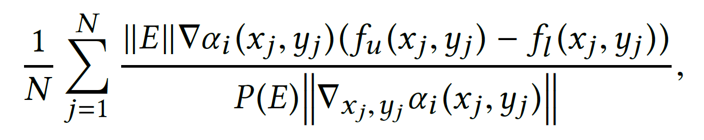
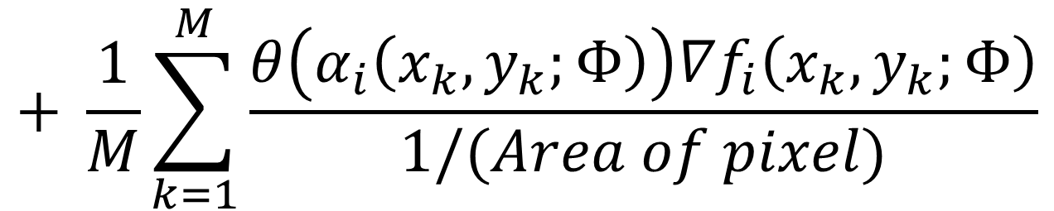
Primary Visibility
MC estimator for the gradient
N : number of samples on edges
M : number of samples in the total area
∥E∥ : length of the edge E
P (E) : the probability of selecting edge E.
(change of region)
(internal change)
$$+ \frac{1}{M}\sum_{k=1}^{M}{\frac{θ\left(α_{i}\left(x_{k}, y_{k};Φ\right)\right){∇f}_{i}\left(x_{k}, y_{k};Φ\right)}{1/(Area of pixel)}}$$
Differentiable MC Ray Tracing

Slide 37


Secondary visibility
$I= \iint_{A(Φ)}{f(x, y;Φ) }$
$∇I$ = (internal change) + (change of region)
= $\iint_{A(Φ)}{∇f(x, y;Φ) }$ + $\int_{∂A\left(Φ\right)}{f\left(x, y;Φ\right)\vec{v}∙ds}$
$Computing ∇f\left(x, y;Φ\right)$ may not be easy!
Differentiable MC Ray Tracing

Slide 38


Secondary visibility
$I= \iint_{A(Φ)}{f(x, y;Φ) }$
$∇I$ = (internal change) + (change of region)
= $\iint_{A(Φ)}{∇f(x, y;Φ) }$ + $\int_{∂A\left(Φ\right)}{f\left(x, y;Φ\right)\vec{v}∙ds}$
Rendering Equation!
$f(x, y;Φ)$ = $\iint_{Surfaces over scene}{\text{h}\text{(}x, y\text{,}m;Φ\text{)}\text{dA}\text{(}m\text{)}}$
Again given by integral of discontinuous function.
Differentiable MC Ray Tracing

Slide 39
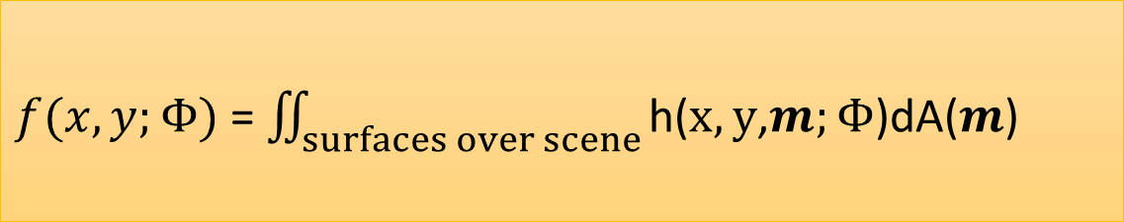
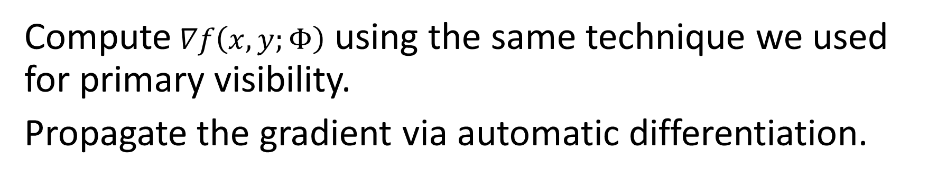
Secondary visibility
$f(x, y;Φ)$ = $\iint_{surfaces over scene}{\text{h}\text{(}x, y\text{,}m;Φ\text{)}\text{dA}\text{(}m\text{)}}$
Compute $∇f\left(x, y;Φ\right)$ using the same technique we used for primary visibility.
Propagate the gradient via automatic differentiation.
Differentiable MC Ray Tracing

Slide 40
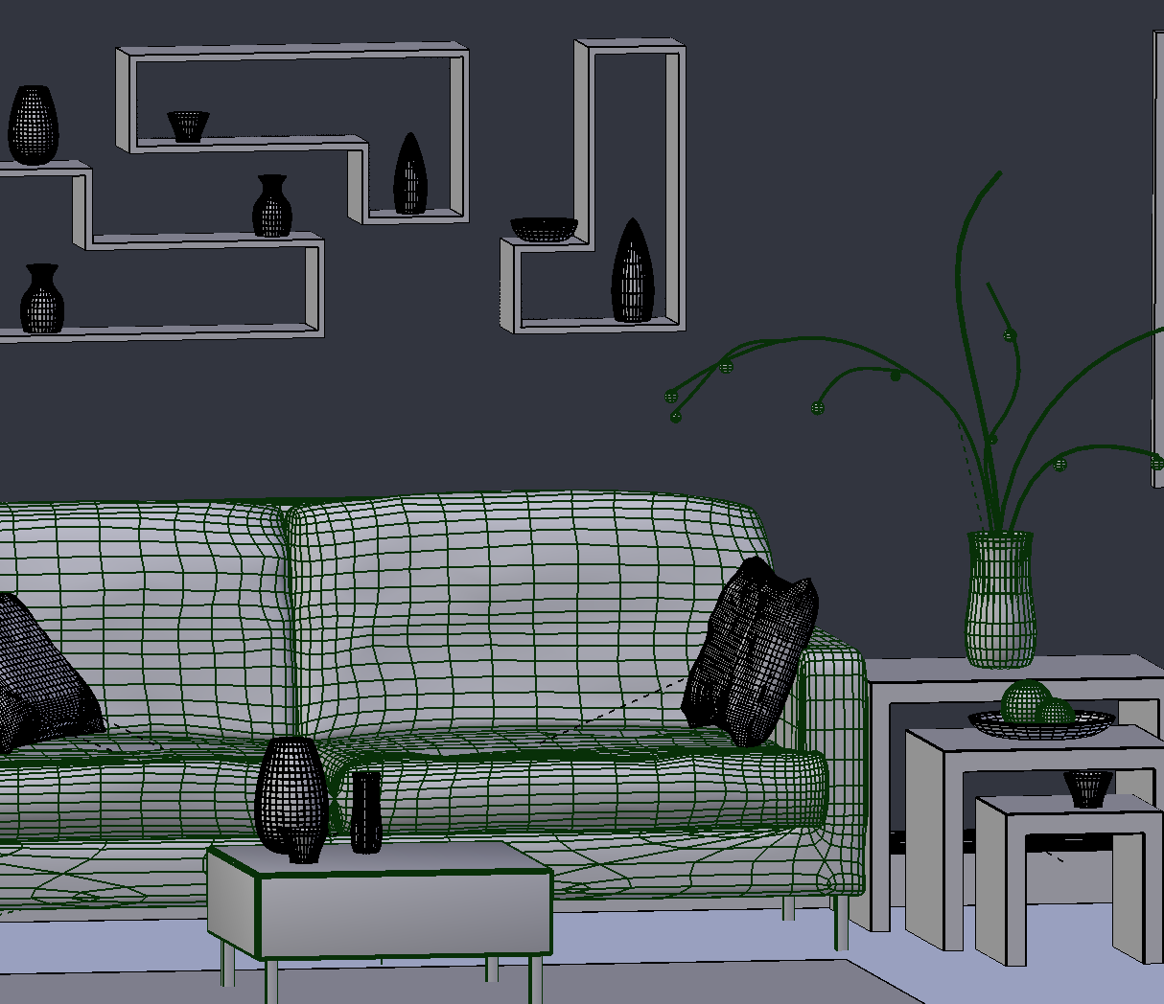

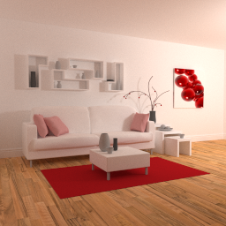

Experiment
Inverse graphics with Derivatives
evaluation
Update $Φ$
update
L1 distance
Possible parameters:
positions of vertices
camera pose
materials
…
image
  ∇ loss
target
From Tzu-Mao’s slides
Notes:
You then update the 3D scene using the gradients of a loss function, so it minimizes the distance between your output and the target.
(pause)

Slide 41
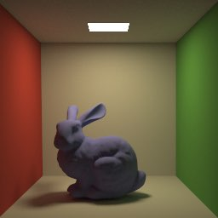
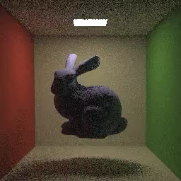
Result
Inverse graphics with Derivatives
From Tzu-Mao’s slides

Slide 42
Inverse graphics with Derivatives
Difference
render
3D scene
target
From Tzu-Mao’s slides

Slide 43
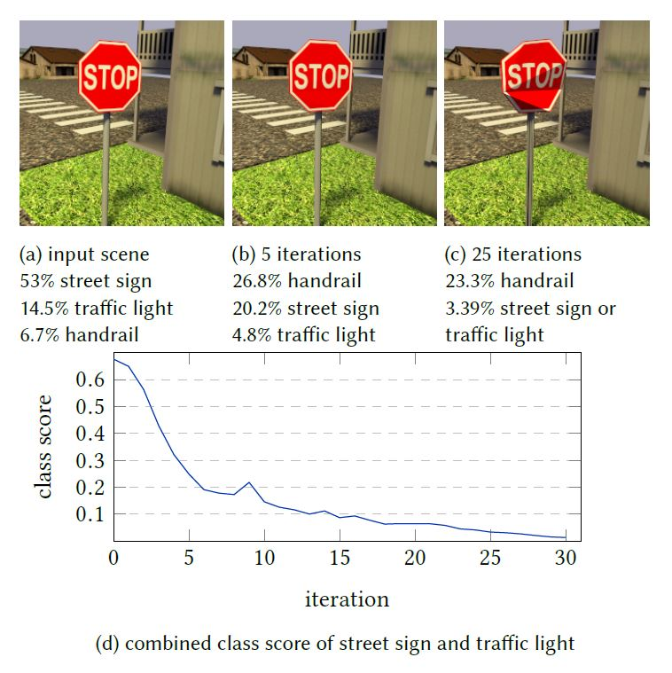
Result
3D adversarial examples
From Tzu-Mao’s slides

Slide 44
Summary
Differentiation with respect to various scene parameters.
Exact gradient (unbiased) by adding the correction term using edge sampling.
Efficient Monte Carlo sampling required, especially for edges.

Slide 45
Quiz
1. Back propagation is ( ) mode automatic differentiation, which is useful when output has much smaller dimension than the input.
  (a) Forward (b) Reverse
Gradient computed by 3D neural mesh renderer is ( ) because of linear interpolation, while differentiable MC ray tracer gives an estimation of ( ) gradient
(a) approximate / exact (b) exact / approximate

