Slide 1
CS380 Lab 1
2017 Spring
Myungbae Son

Slide 2
Acknowledgement
The reference material has been brought from
OpenGL course slides by Rasmus Stenholt
OpenGL course slides by Donghyuk Kim
http://nehe.gamedev.net/
http://www.opengl-tutorial.org/

Slide 3
Goal
Introduce OpenGL programming
Lab 1: OpenGL version 2.x and under
Help you do CS380 homework by yourself
Lab 2: OpenGL version 3.x and above
Dip into modern OpenGL

Slide 4
Notes
Our lab assumes following environment
C++ programming language … (prerequisite!)
Microsoft Windows, MSVC 14.0 (Visual Studio 2015)
You can program in other platforms and submit the code
Avoid platform-specific features to prevent unexpected score deduction
TAs will score your PA based on above environment
Any question while following the tutorial? Ask us!
Off-session questions go to KLMS

Slide 5
Getting Started

Slide 6
Today’s Outline
Set up OpenGL development environments on Visual Studio
Download and setup GLUT and others
Start with the OpenGL framework
Draw a OpenGL primitive
Address keyboard and mouse input

Slide 7
OpenGL is an API for graphics programming
Platform-independent
Same code to render the image for Windows and iPhone
Language-independent
Use same gl*() functions in any popular languages
API is a specification
Your OS provides the OpenGL interface
Your graphic card driver implements OpenGL functions
Driver
OS
Your application

Slide 8
GLUT
Different platforms, Different window systems
Connecting OpenGL to window system is NOT platform-independent
Windows Win32 API, X11 GLX, macOS Cocoa binding, etc..
Tricky, cumbersome and dirty to implement
GLUT (OpenGL Utility Toolkit)
Third-party utility library
Provides a platform-independent window and OpenGL context creation
Saves you from platform-specific hurdles

Slide 9
Download GLUT
Windows binaries and build toolkits can be downloaded from:
https://www.opengl.org/resources/libraries/glut/glutdlls37beta.zip
https://goo.gl/av1Lrr
Unzip it somewhere (Here we assume the location is C:\GLUT)

Slide 10
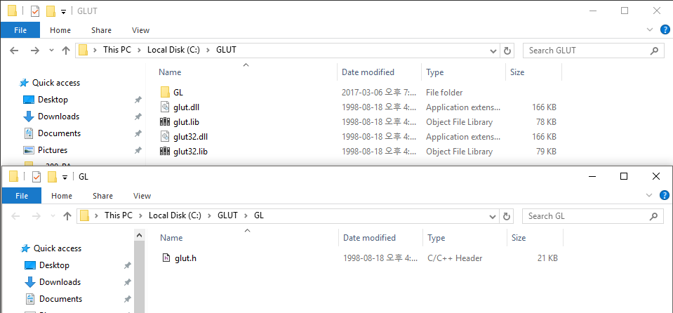
Download GLUT
For standard compliance
Create GL folder inside the folder
Move glut.h into GL folder

Slide 11
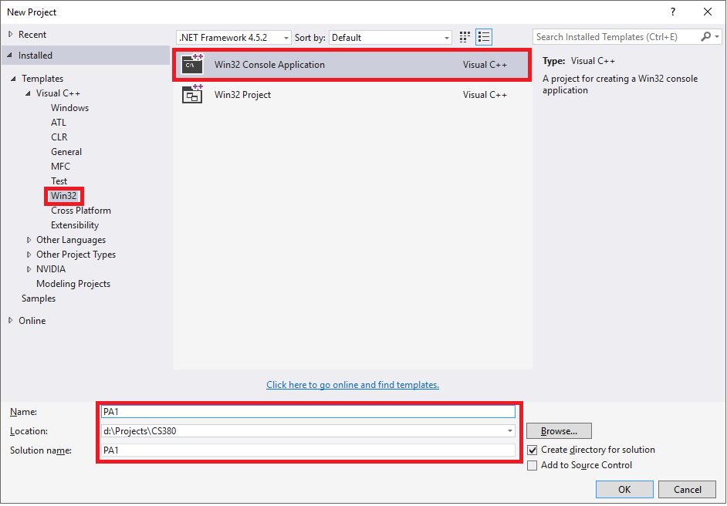
Create Project
Run Visual Studio
File -> New -> Project
Create Win32 Console Application
Type in your project name

Slide 12
Create Project
Run Visual Studio
File -> New -> Project
Create Win32 Console Application
Type in your project name

Slide 13
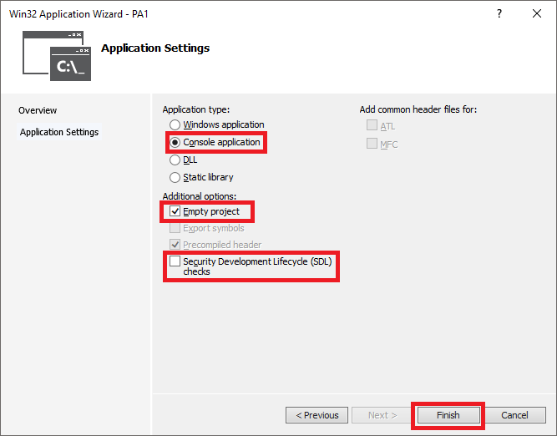
Create Project
Run Visual Studio
File -> New -> Project
Create Win32 Console Application
Type in your project name
Create an empty project
You might want to remove SDL checks as well

Slide 14
Download PA1 Skeleton Code
Available from our course website
Unzip it to project folder (where *.vcxproj resides)

Slide 15
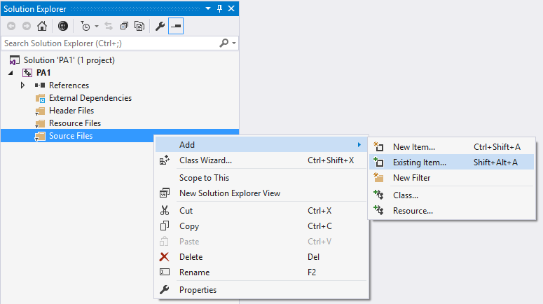
Download PA1 Skeleton Code
Add skeleton code to project

Slide 16
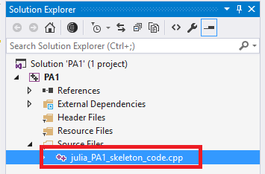
Download PA1 Skeleton Code
Add skeleton code to project

Slide 17
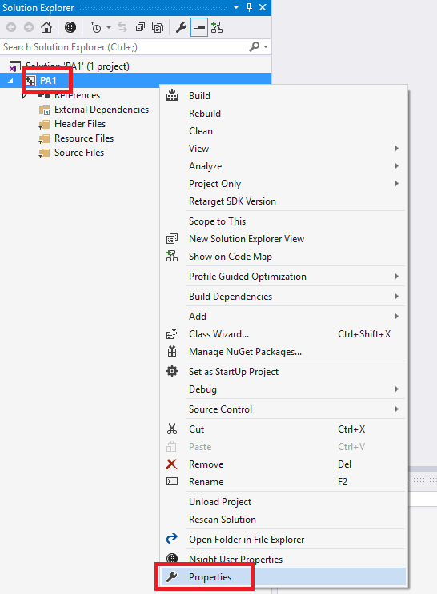
Project Setup
Go to project properties

Slide 18
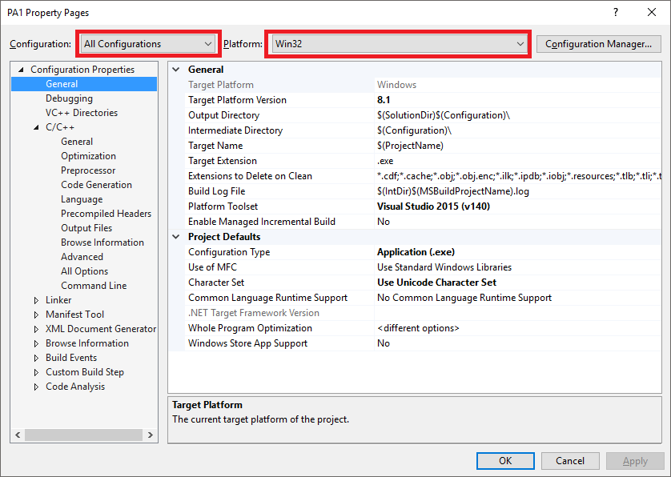
Project Setup
Go to project properties
Make sure that
We’re setting both debug and release modes (All Configuration)
We’re making 32 bit binary (Win32)

Slide 19
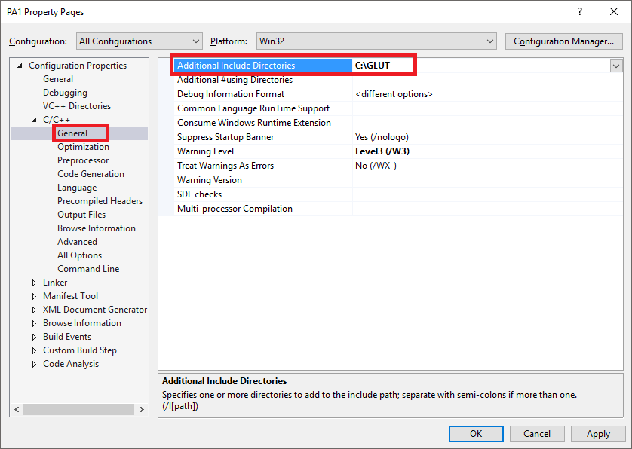
Project Setup
Setup header (*.h) search directory

Slide 20
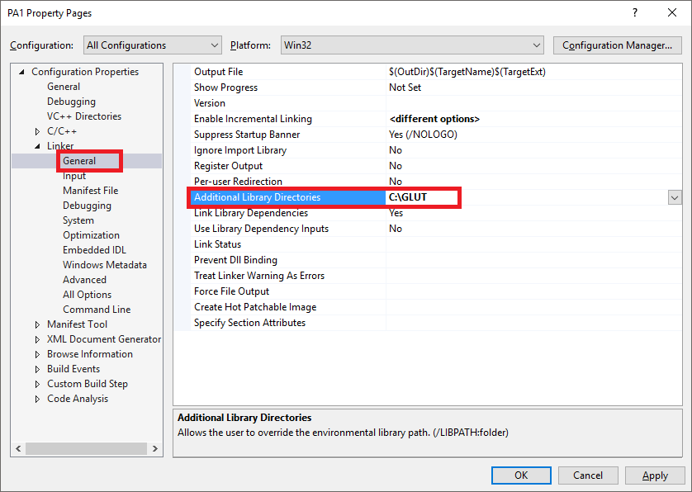
Project Setup
Setup header (*.h) search directory
Setup library (*.lib) search directory

Slide 21
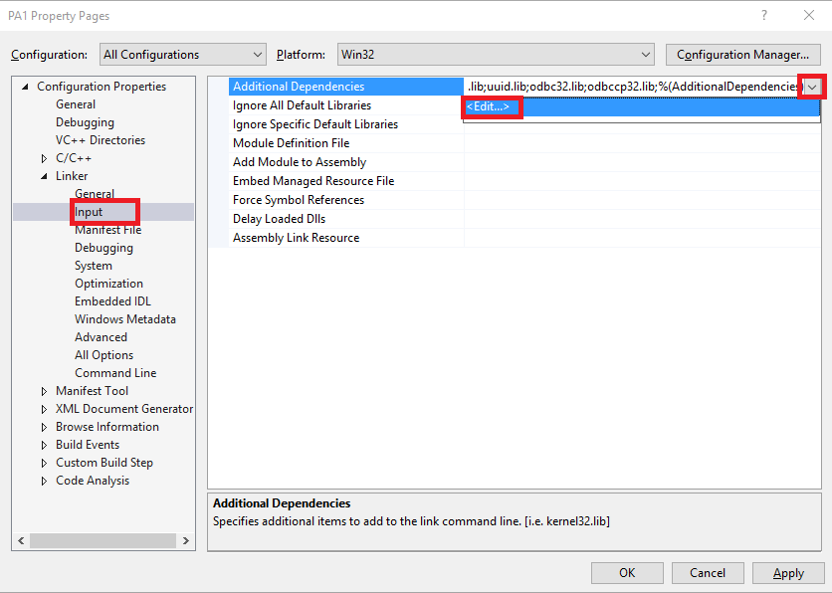
Project Setup
Setup header (*.h) search directory
Setup library (*.lib) search directory
Setup required libraries

Slide 22
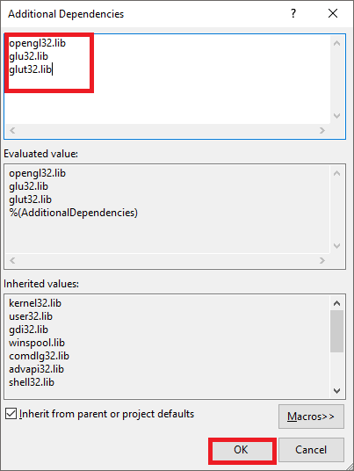
Project Setup
Setup header (*.h) search directory
Setup library (*.lib) search directory
Setup required libraries
OpenGL API libraries (from your OS)
opengl32.lib, glu32.lib
GLUT library
glut32.lib

Slide 23
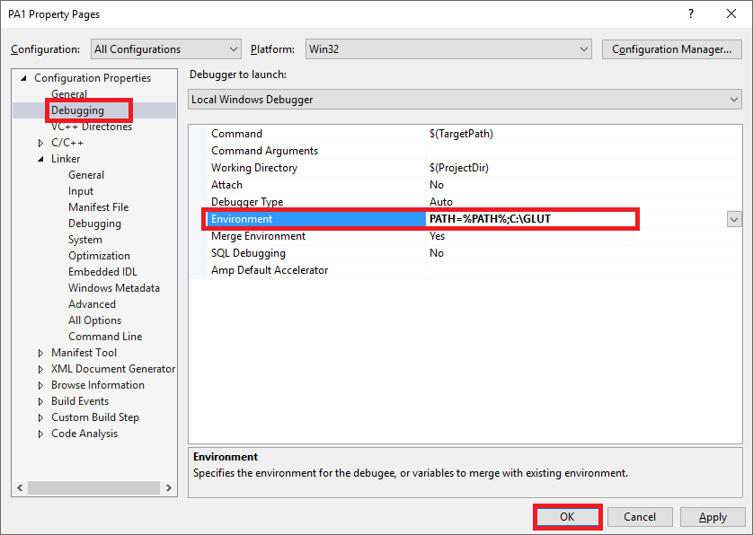
Project Setup
Setup DLL search path when debugging your project
Alternatively, copy glut32.dll file to your *.exe file location
Setup is done, click OK
PATH=%PATH%;<path to glut32.dll directory>

Slide 24
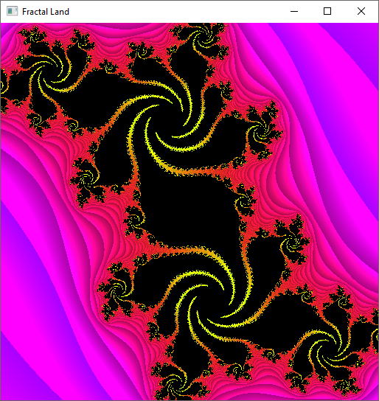
Now Build and Run Project!
F7 for build
Ctrl+F5 for run
F5 for debug run

Slide 25
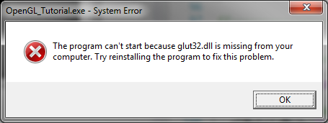
Troubleshooting
Make sure that glut32.dll is within DLL search path
The easiest way is to copy DLL to EXE folder
LNK2026: module unsafe for SAFESEH image.
Set project properties -> Linker -> Advanced -> Image Has Safe Exception Handlers -> No (/SAFESEH:NO)

Slide 26
Creating an empty window
#include <GL/glut.h>
#include <GL/glu.h>
void display()
{
}
int main( int argc, char* argv[] )
{
glutInit(&argc, argv);
glutInitDisplayMode(GLUT_SINGLE | GLUT_RGBA | GLUT_DEPTH);
glutInitWindowSize(512, 512);
glutCreateWindow("CS380 LAB");
glutDisplayFunc( display );
glutMainLoop();
return 0;
}

Slide 27
Draw your first polygon
void display()
Main display function where we can do all the drawing

Slide 28
Draw your first polygon
Clear your screen
void display() {
glClear(GL_COLOR_BUFFER_BIT | GL_DEPTH_BUFFER_BIT);
glFlush();
}
glClear(parameters) // clear input buffers
glFlush() // forces all pending commands to be executed

Slide 29
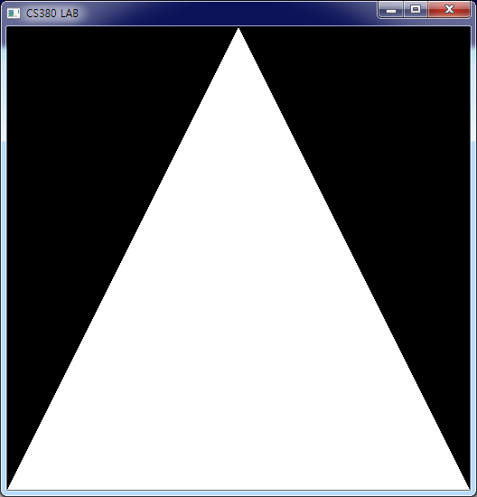
Draw your first polygon
void display() {
glClear(GL_COLOR_BUFFER_BIT | GL_DEPTH_BUFFER_BIT);
glLoadIdentity(); // Reset our view
glBegin(GL_TRIANGLES); // Draw a triangle
glVertex3f( 0.0f, 1.0f, 0.0f);
glVertex3f(-1.0f,-1.0f, 0.0f);
glVertex3f( 1.0f,-1.0f, 0.0f);
glEnd();
glFlush();
}
(0,0,0)

Slide 30
Draw your first polygon
In OpenGL, geometry is specified by vertices
Vertices must be specified between glBegin(primitive type) and glEnd() function calls
The primitive type represents how vertices are to be connected
glBegin(GL_TRIANGLES);
glVertex3f( 0.0f, 1.0f, 0.0f);
glVertex3f(-1.0f,-1.0f, 0.0f);
glVertex3f( 1.0f,-1.0f, 0.0f);
glEnd();

Slide 31
OpenGL Primitives
Triangles
There are 3 ways of making triangles with OpenGL
Individual triangles
Type is GL_TRIANGLES
Each triangle requires 3 explicit vertices
Sets of unconnected triangles are often called polygon soups
Strips of connected triangles
Type is GL_TRIANGLE_STRIP
The first triangle requires 3 vertices, the rest use 1 new vertex and the 2 most recently defined vertices
Complex objects are often built from
Fans of connected triangles
Type is GL_TRIANGLE_FAN
Every triangle use the first, the previous, and a new vertex
Useful for creating polygons or approximating circles/ellipses
GL_TRIANGLES
GL_TRIANGLE_STRIP
GL_TRIANGLE_FAN

Slide 32
OpenGL Primitives
Quadrilaterals (quads)
Individual quads
Type is GL_QUADS
A quad is defined by 4 vertices
Quads can be decomposed into two triangles
Quads are not necessarily plane or convex
Be careful with the vertex sequence
Strips of connected quads
Type is GL_QUAD_STRIP
Uses the most recent 2 vertices and 2 new vertices
GL_QUADS
GL_QUAD_STRIP

Slide 33
OpenGL Primitives
Polygons
Type is GL_POLYGON
Polygons need 3 or more vertices
I.e. can be used for any polygon
Polygons are divided into triangles by the graphics card
GL_POLYGON

Slide 34
OpenGL Primitives
Points
Type is GL_POINTS
Points are 0-D
Points represent the simplest drawable primitive
1 vertex is used per point
Points are rendered as small, unconnected dots on the screen
Theoretically points have no area
GL_POINTS

Slide 35
OpenGL Primitives
Lines
Type is GL_LINES
Lines are 1-D
Each line needs 2 vertices
Lines have no area
Open series of lines
Type is GL_LINE_STRIP
Closed series of lines
Type is GL_LINE_LOOP
GL_LINES
GL_LINE_STRIP
GL_LINE_LOOP

Slide 36
OpenGL functions
OpenGL functions all follow the same naming conventions
Function names have gl, glu, or glut as prefix depending on their package of origin
The name of the function follows the prefix
The parameter type of the function is placed as a postfix

Slide 37
OpenGL functions
glVertex3fv( v )
Number of
components
Data Type
Vector
b - byte
ub - unsigned byte
s - short
us - unsigned short
i - int
ui - unsigned int
f - float
d - double
omit “v” for
scalar form
glVertex2f( x, y )
2 - (x,y)
3 - (x,y,z)
4 - (x,y,z,w)

Slide 38
Tutorial
Draw this rectangle

Slide 39
Tutorial
Drawing a red rectangle
glBegin(GL_QUADS);
glVertex3f( -0.5f, -0.5f, 0.0f);
glVertex3f(-0.5f, 0.5f, 0.0f);
glVertex3f( 0.5f, 0.5f, 0.0f);
glVertex3f( 0.5f,-0.5f, 0.0f);
glEnd();

Slide 40
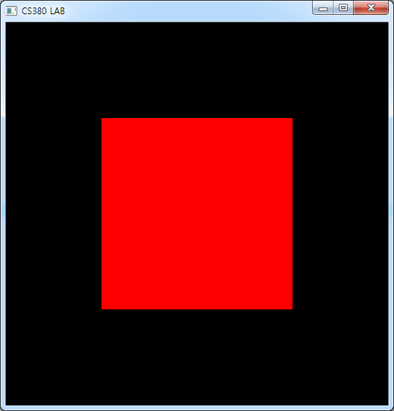
Adding colours
glColor3f(red, green, blue)
Drawing a red rectangle
glBegin(GL_QUADS);
glColor3f(1.0f,0.0f,0.0f);
glVertex3f( -0.5f, -0.5f, 0.0f);
glVertex3f(-0.5f, 0.5f, 0.0f);
glVertex3f( 0.5f, 0.5f, 0.0f);
glVertex3f( 0.5f,-0.5f, 0.0f);
glEnd();

Slide 41
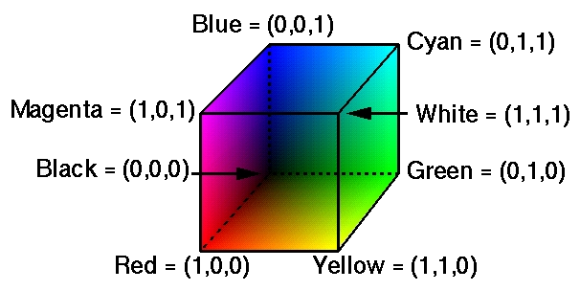
Colours in OpenGL
Colours are modelled using the red-green-blue (RGB) system

Slide 42
Colours in OpenGL
There are several ways of representing colour in OpenGL
Directly as RGB-tuples
Extended RGBA-tuples
Indexed mode
The RGBA mode has an extra component, alpha, which does not affect the colour directly
Alpha is used when blending colours
E.g. transparency effects

Slide 43
Colours in OpenGL
Colours are specified by the glColor*() family of functions
Example: glColor3f()
Specifies a colour by three floating point values in the range [0.0;1.0]
The parameters represent R, G, and B, respectively

Slide 44
Keyboard input
int main( int argc, char* argv[] ) {
glutInit(&argc, argv);
glutInitDisplayMode(GLUT_SINGLE | GLUT_RGBA | GLUT_DEPTH);
glutInitWindowSize( width, height );
glutCreateWindow("CS380");
glutDisplayFunc( display );
glutMouseFunc( mouse );
glutKeyboardFunc( keyboard );
glutReshapeFunc( reshape );
glutMainLoop();
return 0;
}

Slide 45
Keyboard input
void keyboard(unsigned char key, int x, int y) {
if (key == 'r') {
// todo
}
glutPostRedisplay();
}

Slide 46
Tutorial
Change the color of your rectangle
Press ‘r’: change it to a red rectangle
Press ‘g’: change it to a green rectangle
Press ‘b’: change it to a blue rectangle

Slide 47
Tutorial
void keyboard(unsigned char key, int x, int y){
if (key == 'r') {
r = 1.0, g = 0.0, b = 0.0;
}
else if (key == 'g') {
r = 0.0, g = 1.0, b = 0.0;
}
else if (key == 'b') {
r = 0.0, g = 0.0, b = 1.0;
}
glutPostRedisplay();
}
void display() {
…
glColor3f(r,g,b);
…
}

Slide 48
Mouse input
int main( int argc, char* argv[] ) {
glutInit(&argc, argv);
glutInitDisplayMode(GLUT_SINGLE | GLUT_RGBA | GLUT_DEPTH);
glutInitWindowSize( width, height );
glutCreateWindow("CS380");
glutDisplayFunc( display );
glutMouseFunc( mouse );
glutKeyboardFunc( keyboard );
glutReshapeFunc( reshape );
glutMainLoop();
return 0;
}

Slide 49
Mouse input
void mouse( int button, int state, int mx, int my )
button
GLUT_LEFT_BUTTON
GLUT_MIDDLE_BUTTON
GLUT_RIGHT_BUTTON
state
GLUT_DOWN
GLUT_UP
mx, my
positions

Slide 50
Mouse input
void mouse( int button, int state, int mx, int my ) {
if((button == GLUT_LEFT_BUTTON) && (state == GLUT_DOWN) ) {
r = 1.0, g = 1.0, b = 1.0;
display();
}
}

